Slide 1
A Sequential Stopping Problem with Costly Reversibility

Slide 2
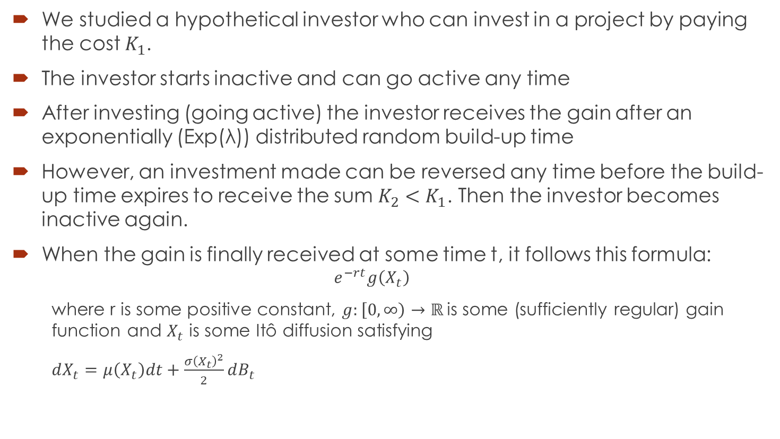
Problem Specification
We studied a hypothetical investor who can invest in a project by paying the cost $K_{1}$.
The investor starts inactive and can go active any time
After investing (going active) the investor receives the gain after an exponentially (Exp(λ)) distributed random build-up time
However, an investment made can be reversed any time before the build-up time expires to receive the sum $K_{2}<K_{1}$. Then the investor becomes inactive again.
When the gain is finally received at some time t, it follows this formula:
  $$e^{−rt}g\left(X_{t}\right)$$
  where r is some positive constant, $g:\left[0, ∞\right)→ℝ$is some (sufficiently regular) gain function and $X_{t}$ is some Itô diffusion satisfying
  $dX_{t}=μ\left(X_{t}\right)dt+\frac{σ{\left(X_{t}\right)}^{2}}{2}dB_{t}$

Slide 3
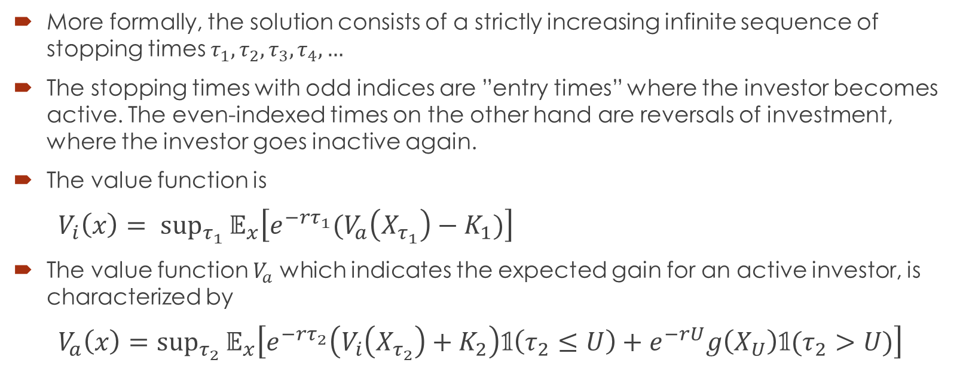
Definition of the problem
More formally, the solution consists of a strictly increasing infinite sequence of stopping times $τ_{1},τ_{2},τ_{3},τ_{4},…$
The stopping times with odd indices are ”entry times” where the investor becomes active. The even-indexed times on the other hand are reversals of investment, where the investor goes inactive again.
The value function is
$V_{i}\left(x\right)= {sup⁡}_{τ_{1}}𝔼_{x}\left[e^{−rτ_{1}}(V_{a}\left(X_{τ_{1}}\right)−K_{1})\right]$
The value function $V_{a}$ which indicates the expected gain for an active investor, is characterized by
$V_{a}\left(x\right)={sup⁡}_{τ_{2}}𝔼_{x}\left[e^{−rτ_{2}}\left(V_{i}\left(X_{τ_{2}}\right)+K_{2}\right)𝟙\left(τ_{2}≤U\right)+e^{−rU}g\left(X_{U}\right)𝟙(τ_{2}>U)\right]$

Slide 4
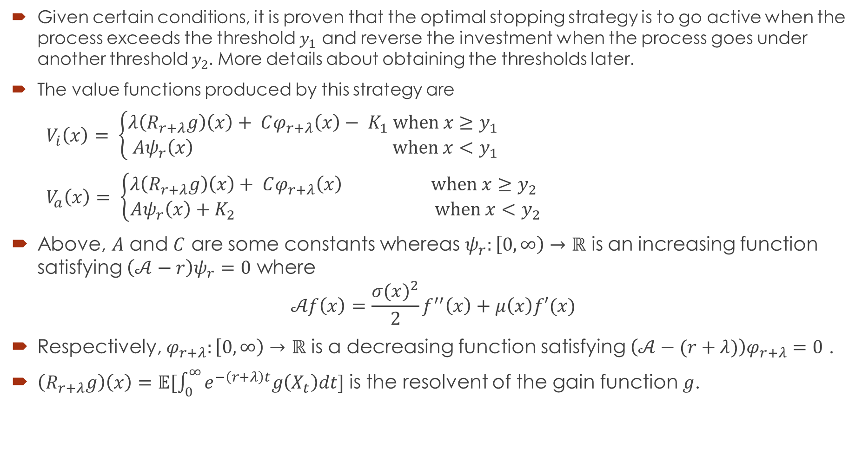
Solution
Given certain conditions, it is proven that the optimal stopping strategy is to go active when the process exceeds the threshold $y_{1}$ and reverse the investment when the process goes under another threshold $y_{2}.$ More details about obtaining the thresholds later.
The value functions produced by this strategy are
$V_{i}\left(x\right)= \left\{\begin{aligned}λ\left(R_{r+λ}g\right)\left(x\right)+ Cφ_{r+λ}\left(x\right)− K_{1} \text{when} x≥y_{1} \\ Aψ_{r}\left(x\right) \text{when} x<y_{1}\end{aligned}\right.$
$V_{a}\left(x\right)= \left\{\begin{aligned}λ\left(R_{r+λ}g\right)\left(x\right)+ Cφ_{r+λ}\left(x\right) \text{when} x≥y_{2} \\ Aψ_{r}\left(x\right)+K_{2} \text{when} x<y_{2}\end{aligned}\right.$
Above, $A$ and $C$ are some constants whereas $ψ_{r}:\left[0, ∞\right)→ℝ$ is an increasing function satisfying $\left(𝒜󠇣−r\right)ψ_{r}=0$ where
$$𝒜f\left(x\right)=\frac{{σ(x)}^{2}}{2}f^{′′}\left(x\right)+μ\left(x\right)f′(x)$$
Respectively, $φ_{r+λ}:\left[0, ∞\right)→$ $ℝ$ is a decreasing function satisfying $\left(𝒜󠇣−(r+λ)\right)φ_{r+λ}=0$ .
$\left(R_{r+λ}g\right)\left(x\right)=𝔼[\int_{0}^{∞}{e^{−\left(r+λ\right)t}g\left(X_{t}\right)dt]}$ is the resolvent of the gain function $g$.

Slide 5
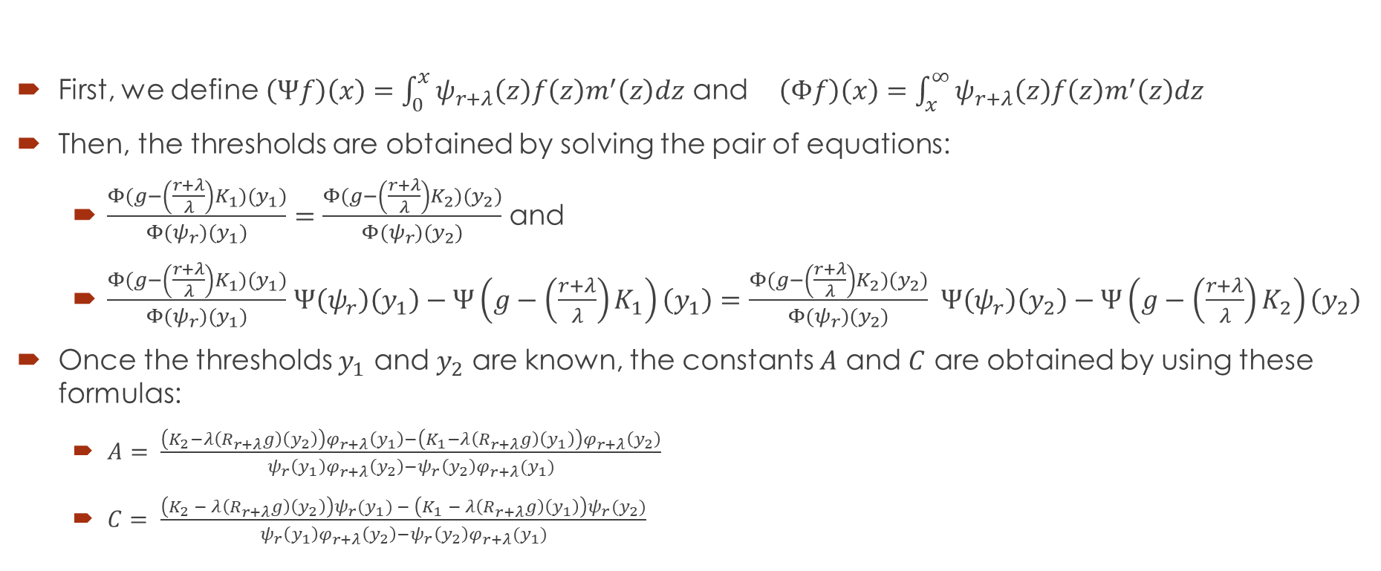
Thresholds and constants of the solution
First, we define $\left(Ψf\right)\left(x\right)=\int_{0}^{x}{ψ_{r+λ}\left(z\right)f\left(z\right)m^{′}\left(z\right)dz}$ and $\left(Φf\right)\left(x\right)=\int_{x}^{∞}{ψ_{r+λ}\left(z\right)f\left(z\right)m^{′}\left(z\right)dz}$
Then, the thresholds are obtained by solving the pair of equations:
  $\frac{Φ(g−\left(\frac{r+λ}{λ}\right)K_{1})(y_{1})}{Φ(ψ_{r})(y_{1})}=\frac{Φ(g−\left(\frac{r+λ}{λ}\right)K_{2})(y_{2})}{Φ(ψ_{r})(y_{2})}$ and
  $\frac{Φ(g−\left(\frac{r+λ}{λ}\right)K_{1})(y_{1})}{Φ(ψ_{r})(y_{1})}$ $Ψ\left(ψ_{r}\right)\left(y_{1}\right)−Ψ\left(g−\left(\frac{r+λ}{λ}\right)K_{1}\right)\left(y_{1}\right)=\frac{Φ(g−\left(\frac{r+λ}{λ}\right)K_{2})(y_{2})}{Φ(ψ_{r})(y_{2})} Ψ\left(ψ_{r}\right)\left(y_{2}\right)−Ψ\left(g−\left(\frac{r+λ}{λ}\right)K_{2}\right)\left(y_{2}\right)$
Once the thresholds $y_{1}$ and $y_{2}$ are known, the constants $A$ and $C$ are obtained by using these formulas:
  $A= \frac{\left(K_{2}−λ\left(R_{r+λ}g\right)\left(y_{2}\right)\right)φ_{r+λ}\left(y_{1}\right)−\left(K_{1}−λ\left(R_{r+λ}g\right)\left(y_{1}\right)\right)φ_{r+λ}\left(y_{2}\right)}{ψ_{r}\left(y_{1}\right)φ_{r+λ}\left(y_{2}\right)−ψ_{r}\left(y_{2}\right)φ_{r+λ}(y_{1})}$
  $C= \frac{\left(K_{2} − λ\left(R_{r+λ}g\right)\left(y_{2}\right)\right)ψ_{r}(y_{1}) − \left(K_{1} − λ\left(R_{r+λ}g\right)\left(y_{1}\right)\right)ψ_{r}(y_{2})}{ψ_{r}\left(y_{1}\right)φ_{r+λ}\left(y_{2}\right)−ψ_{r}\left(y_{2}\right)φ_{r+λ}(y_{1})}$

Slide 6
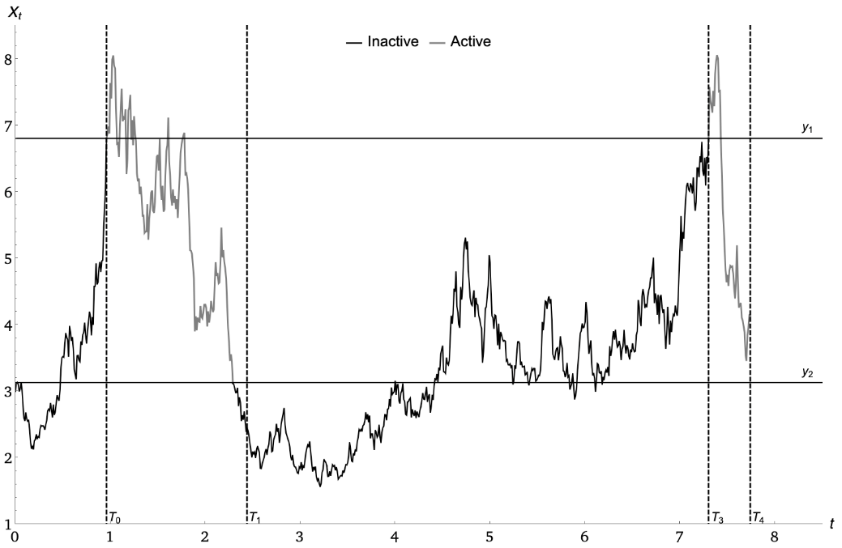
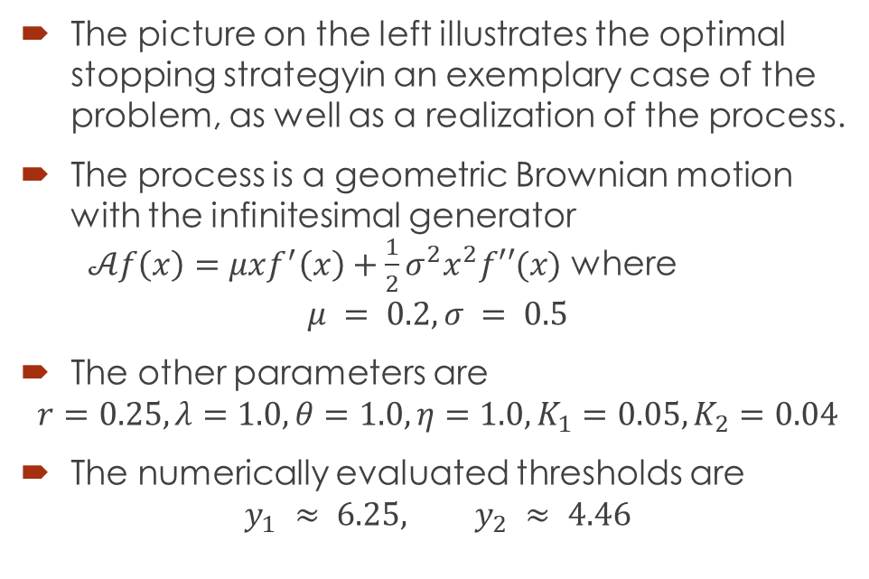
An illustration
The picture on the left illustrates the optimal stopping strategyin an exemplary case of the problem, as well as a realization of the process.
The process is a geometric Brownian motion with the infinitesimal generator $𝒜f\left(x\right)=μxf^{′}\left(x\right)+\frac{1}{2}σ^{2}x^{2}f′′(x)$ where
$$μ = 0.2, σ = 0.5$$
The other parameters are
$$r=0.25, λ=1.0,θ=1.0, η=1.0, K_{1}=0.05,K_{2}=0.04$$
The numerically evaluated thresholds are
$$y_{1} ≈ 6.25, y_{2} ≈ 4.46$$

